Slide 1



CSE 299
Cadence
A virtual co-sharing platform for you

Slide 2


Contents
Problem Statement
Methodology
Conclusion
Features
Tools & Technology

Slide 3




“You’re distracted by social media but still have deadlines to meet. What if a social platform could actually help you stay focused?”
“”you
‘Cadence’ our one step solution

Slide 4
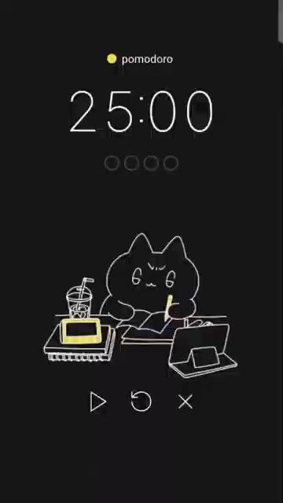
Our Inspiration
Here’s an example of Pomodoro timer where we can set, reset and pause the timer to avoid any distraction.

Slide 5
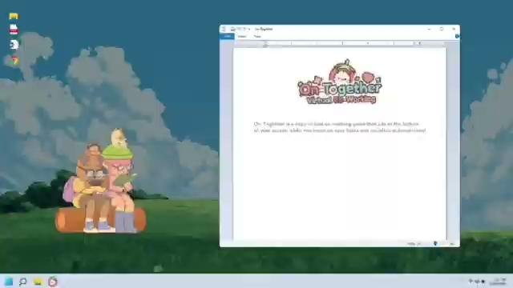
Our Inspirations
The game that inspire us is “On-together”.
It’s an application based game where multiple players can have their own chat room and they can also focus on their own works but our goal is to build a web based focus-chat room which will be free for all.

Slide 6

Our Inspiration
Unlike, “On-together” our web based game, Cadence will have 2D characters. So, the avatar design will be somewhat similar(known as Chibi style where the head is bigger than the body just for the sake of being cute) to another mobile app game called “Pocket-love”.

Slide 7
Use Cases:
Remote Work or Personal Project:
Exam & Deadline Preparation:
A remote worker or hobbyist joins a room while doing office tasks, coding, writing, or creative work. Even without talking, seeing others working helps them stay focused and avoid distractions.
A student or professional joins a Cadence room before an exam or deadline. Everyone follows the same focus timer, works quietly and can have brief discussions when needed. Seeing others working at the same time helps all to stay motivated and focused.

Slide 8
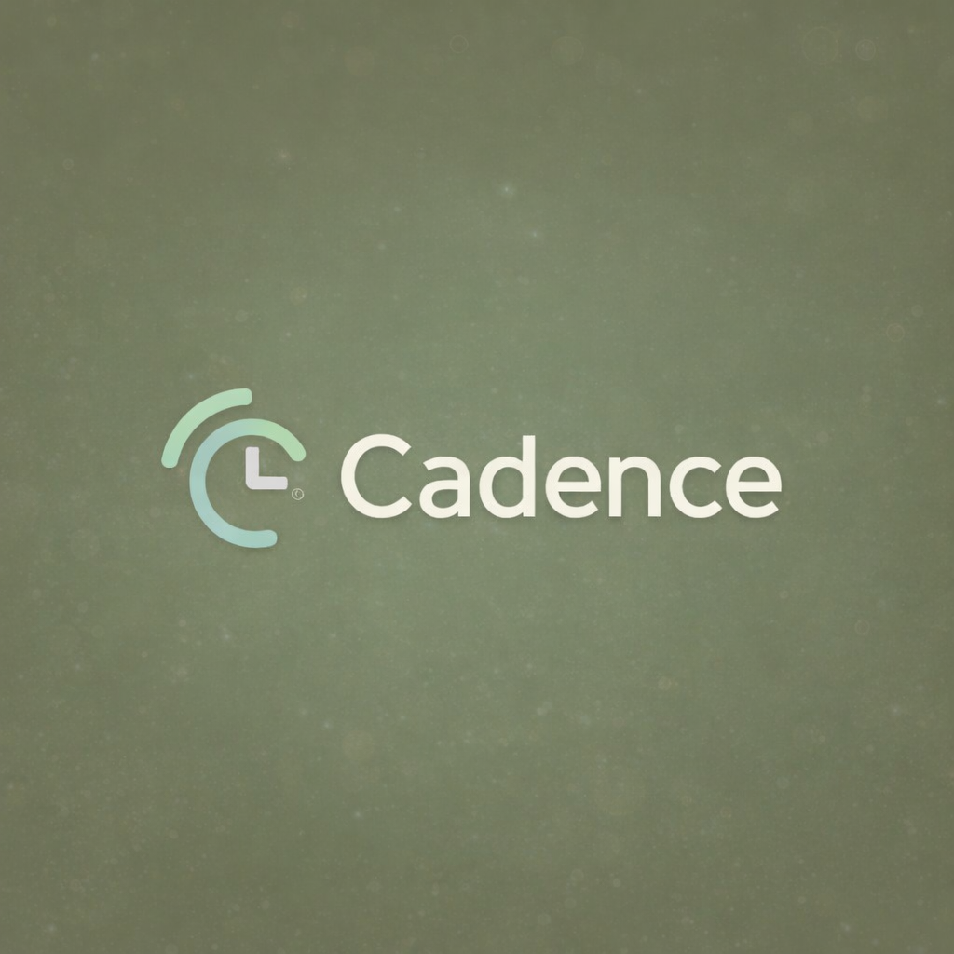
PROJECT OBJECTIVES
Build a virtual co‑working space for the web
Support shared focus sessions with a synced time
Show live activity from everyone in the room
Keep things calm while still making teamwork easy

Slide 9
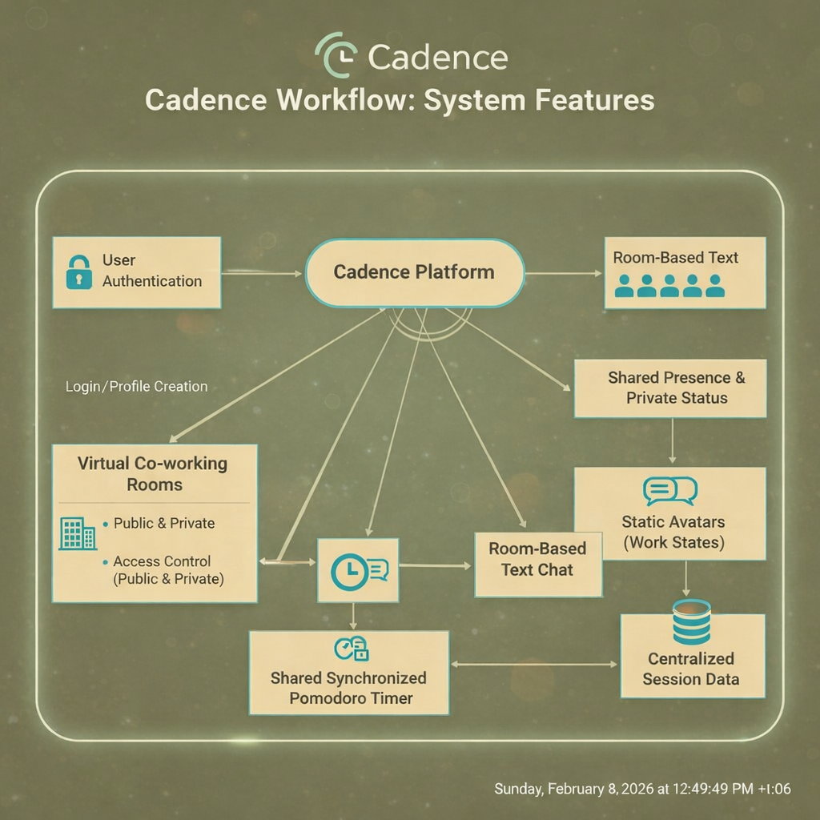
SYSTEM FEATURES
User authentication and profiles
Public & private virtual rooms
Shared Pomodoro-based focus timer
Real-time presence & activity status
Room-based text communication
2D avatars reflecting user state
Session history & productivity data
Clean, minimal, responsive UI

Slide 10
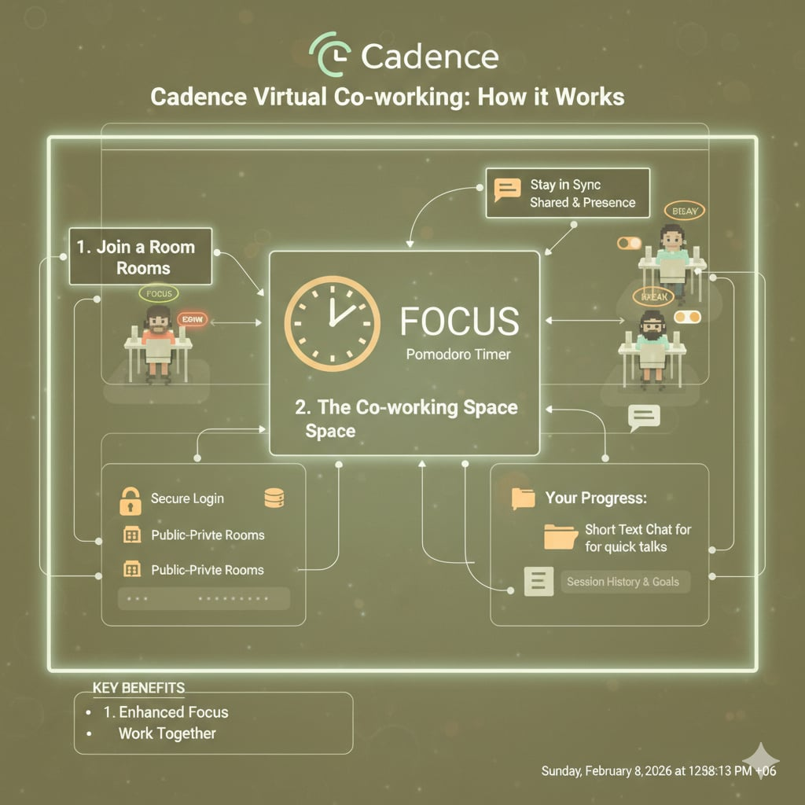

Slide 11
Methodology
System Components and their Roles - Who Handles What
User :
User accesses the platform via web browser
Sends action to backend (join room, start time, send message and etc)
Backend :
Room and session management
User authentication
Tracks and updates user activity
Real-time coordination
Frontend :
Displays user avatar, timers and chat in real-time
Responsible for visual updates
Sends user action to backend
Database:
Stores all user records and data
Connects different entities (users and rooms, users and characters)
Company Name
Date

Slide 12


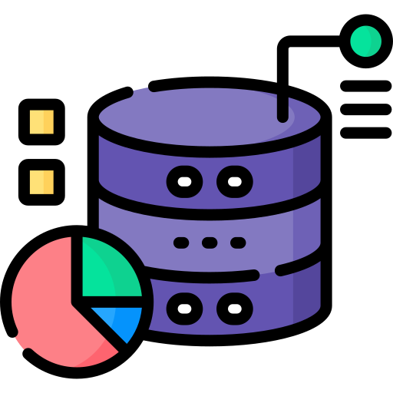
Tools and Technology
Why this stack?
Our proposed developer stack
Frontend
Backend
Database
Wanted to learn and use a reliable Python framework
Django gives support for real-time updates
Standard frontend tools
Ensure data consistency and scalable
HTML
CSS
Javascript
Django
Python
Django Channel (Websockets)
PostgreSQL
SQLlite
Company Name
Date

Slide 13
CONCLUSION
Cadence offers a purpose-driven alternative to social platforms
Focuses on:
Productivity
Shared presence
Synchronized activity
Serve as both
A functional productivity tool
An academic demonstration of real-time web systems

